Slide 1
Memcache

Slide 2
sessions

Slide 3
App Engine Sessions - Three Options:
Use Google logins and their session
Use Gorilla sessions with manual routing
(either via http.ServeMux or some other router)
Use a Session ID and Memcache
do a regular cookie
store in that cookie a session ID
use memcache for their session

Slide 4
memcache

Slide 5
Memcache backstory
servers weren’t using all of their capacity
eg, had 1GB RAM but only 100 MB used
memcache built to use it

Slide 6
Memcache
a big map distributed across all of your machines
“a big distributed map”
memcache is
very fast
you’re storing things in memory
you can use memcache to improve data retrieval performance
cache database queries in memcache
is it in memcache?
yes - great, get it from memcache
no - do the datastore query, get it, then store it in memcache
this decreases load on database which increases performance
you can use memcache for sessions
instead of storing user data in a cookie, store it in memcache

Slide 7
Why not just use a map
instead of memcache?

Slide 8
server
server
load balancer
memcache
server

Slide 9
If you need something to absolutely be there,
use a real database

Slide 10
memcache docs

Slide 11
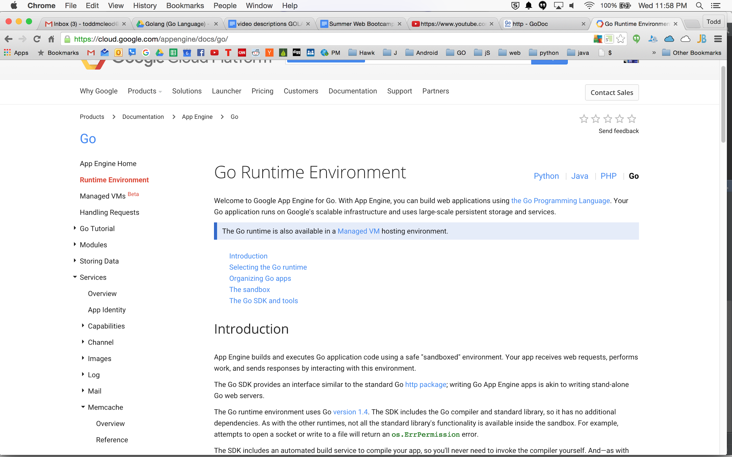

Slide 12
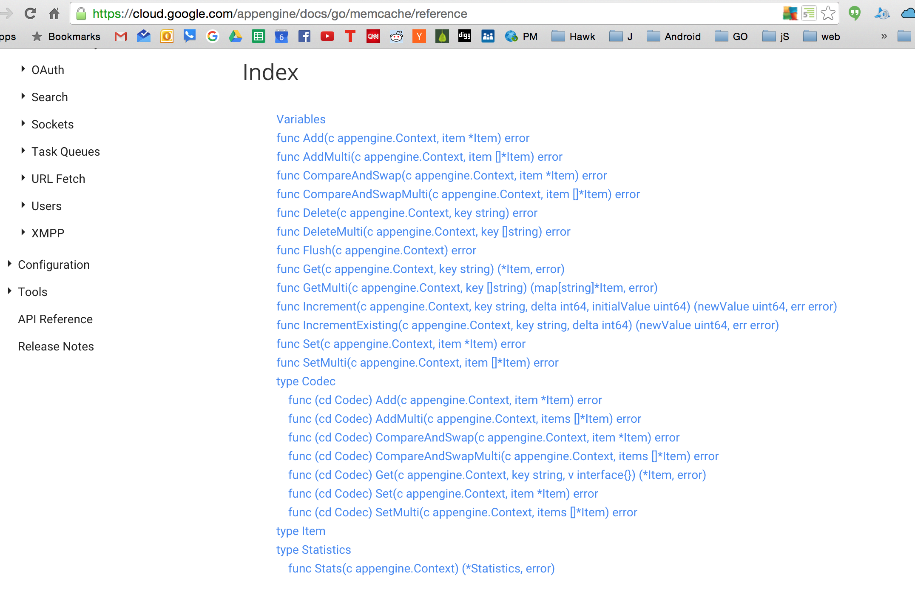

Slide 13
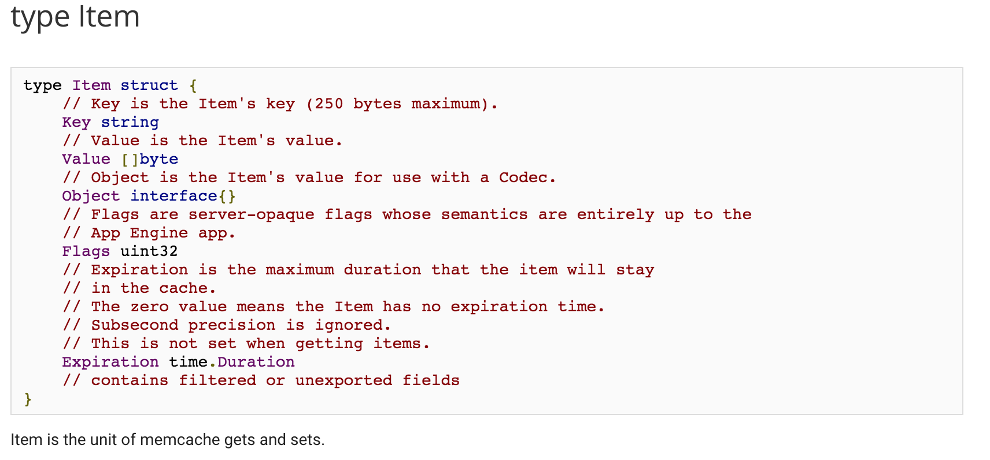

Slide 14
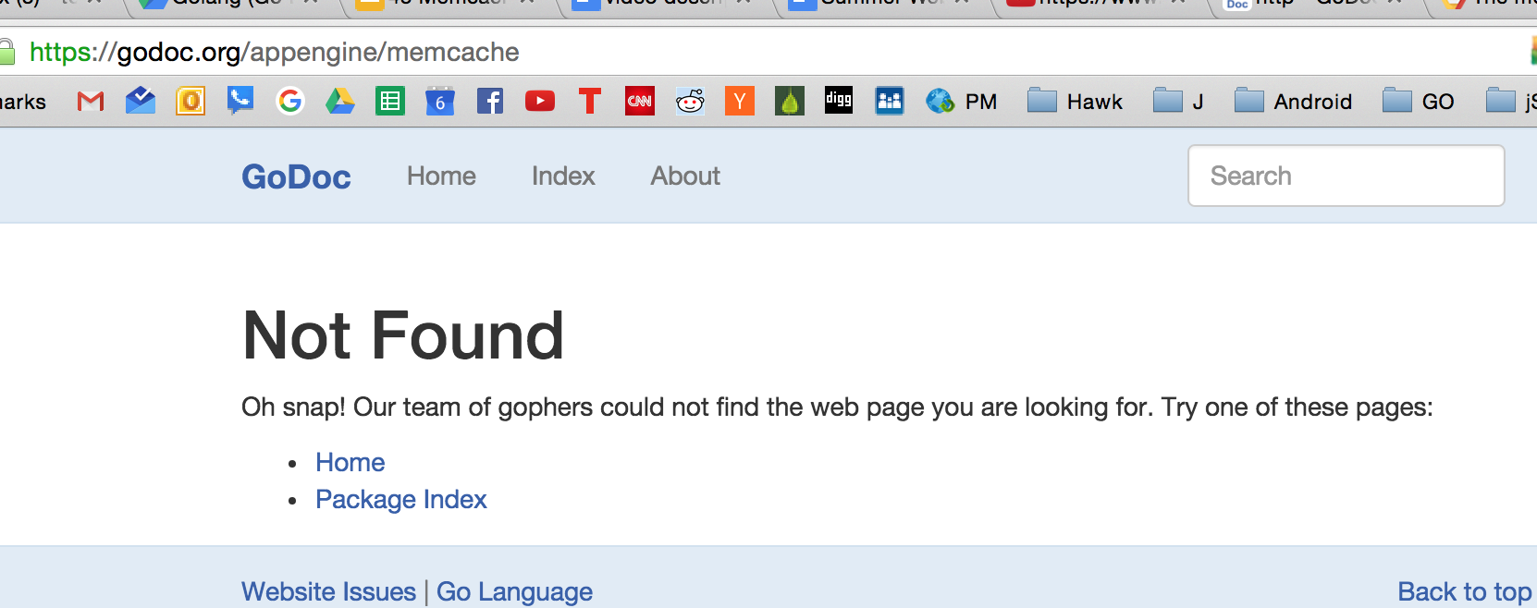
FYI

Slide 15
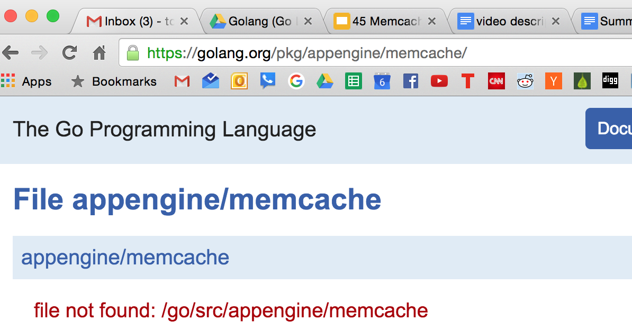
FYI

Slide 16
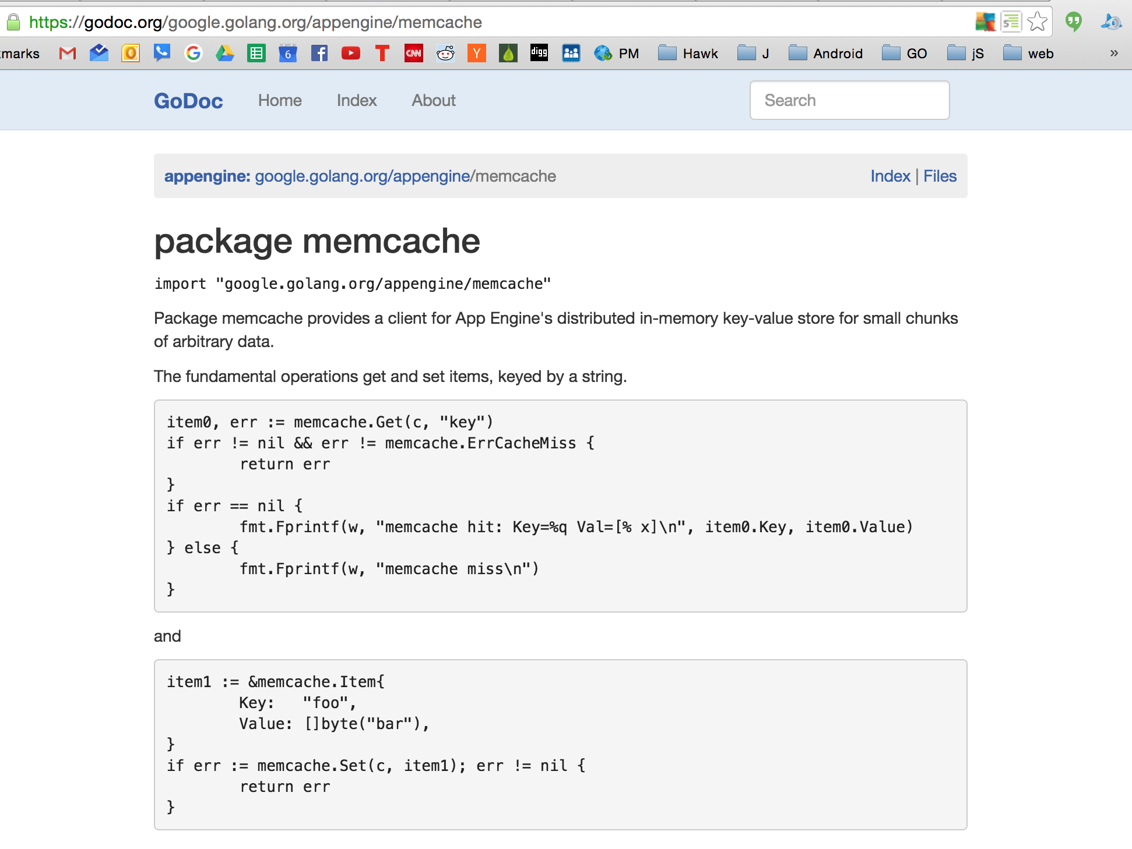
FYI

Slide 17
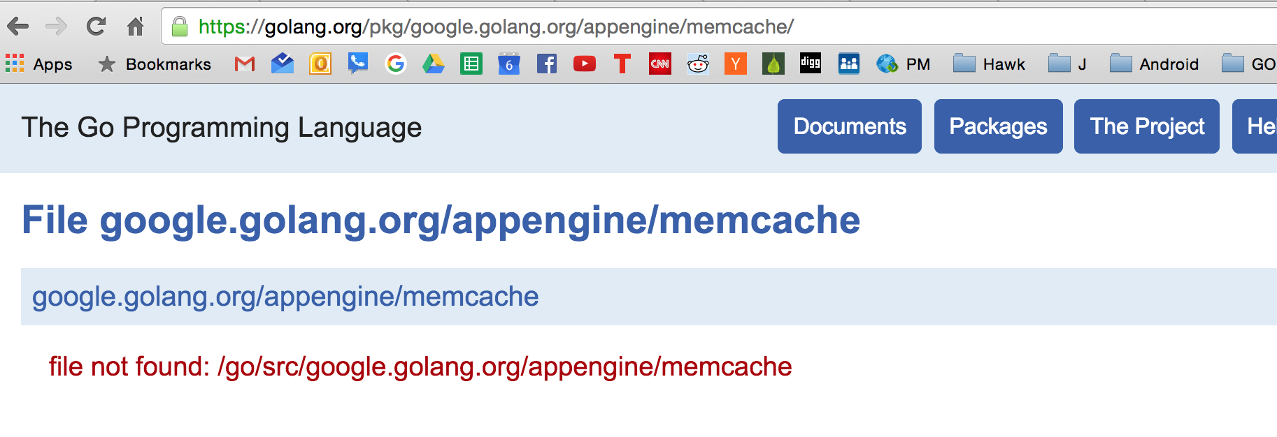
FYI

Slide 18
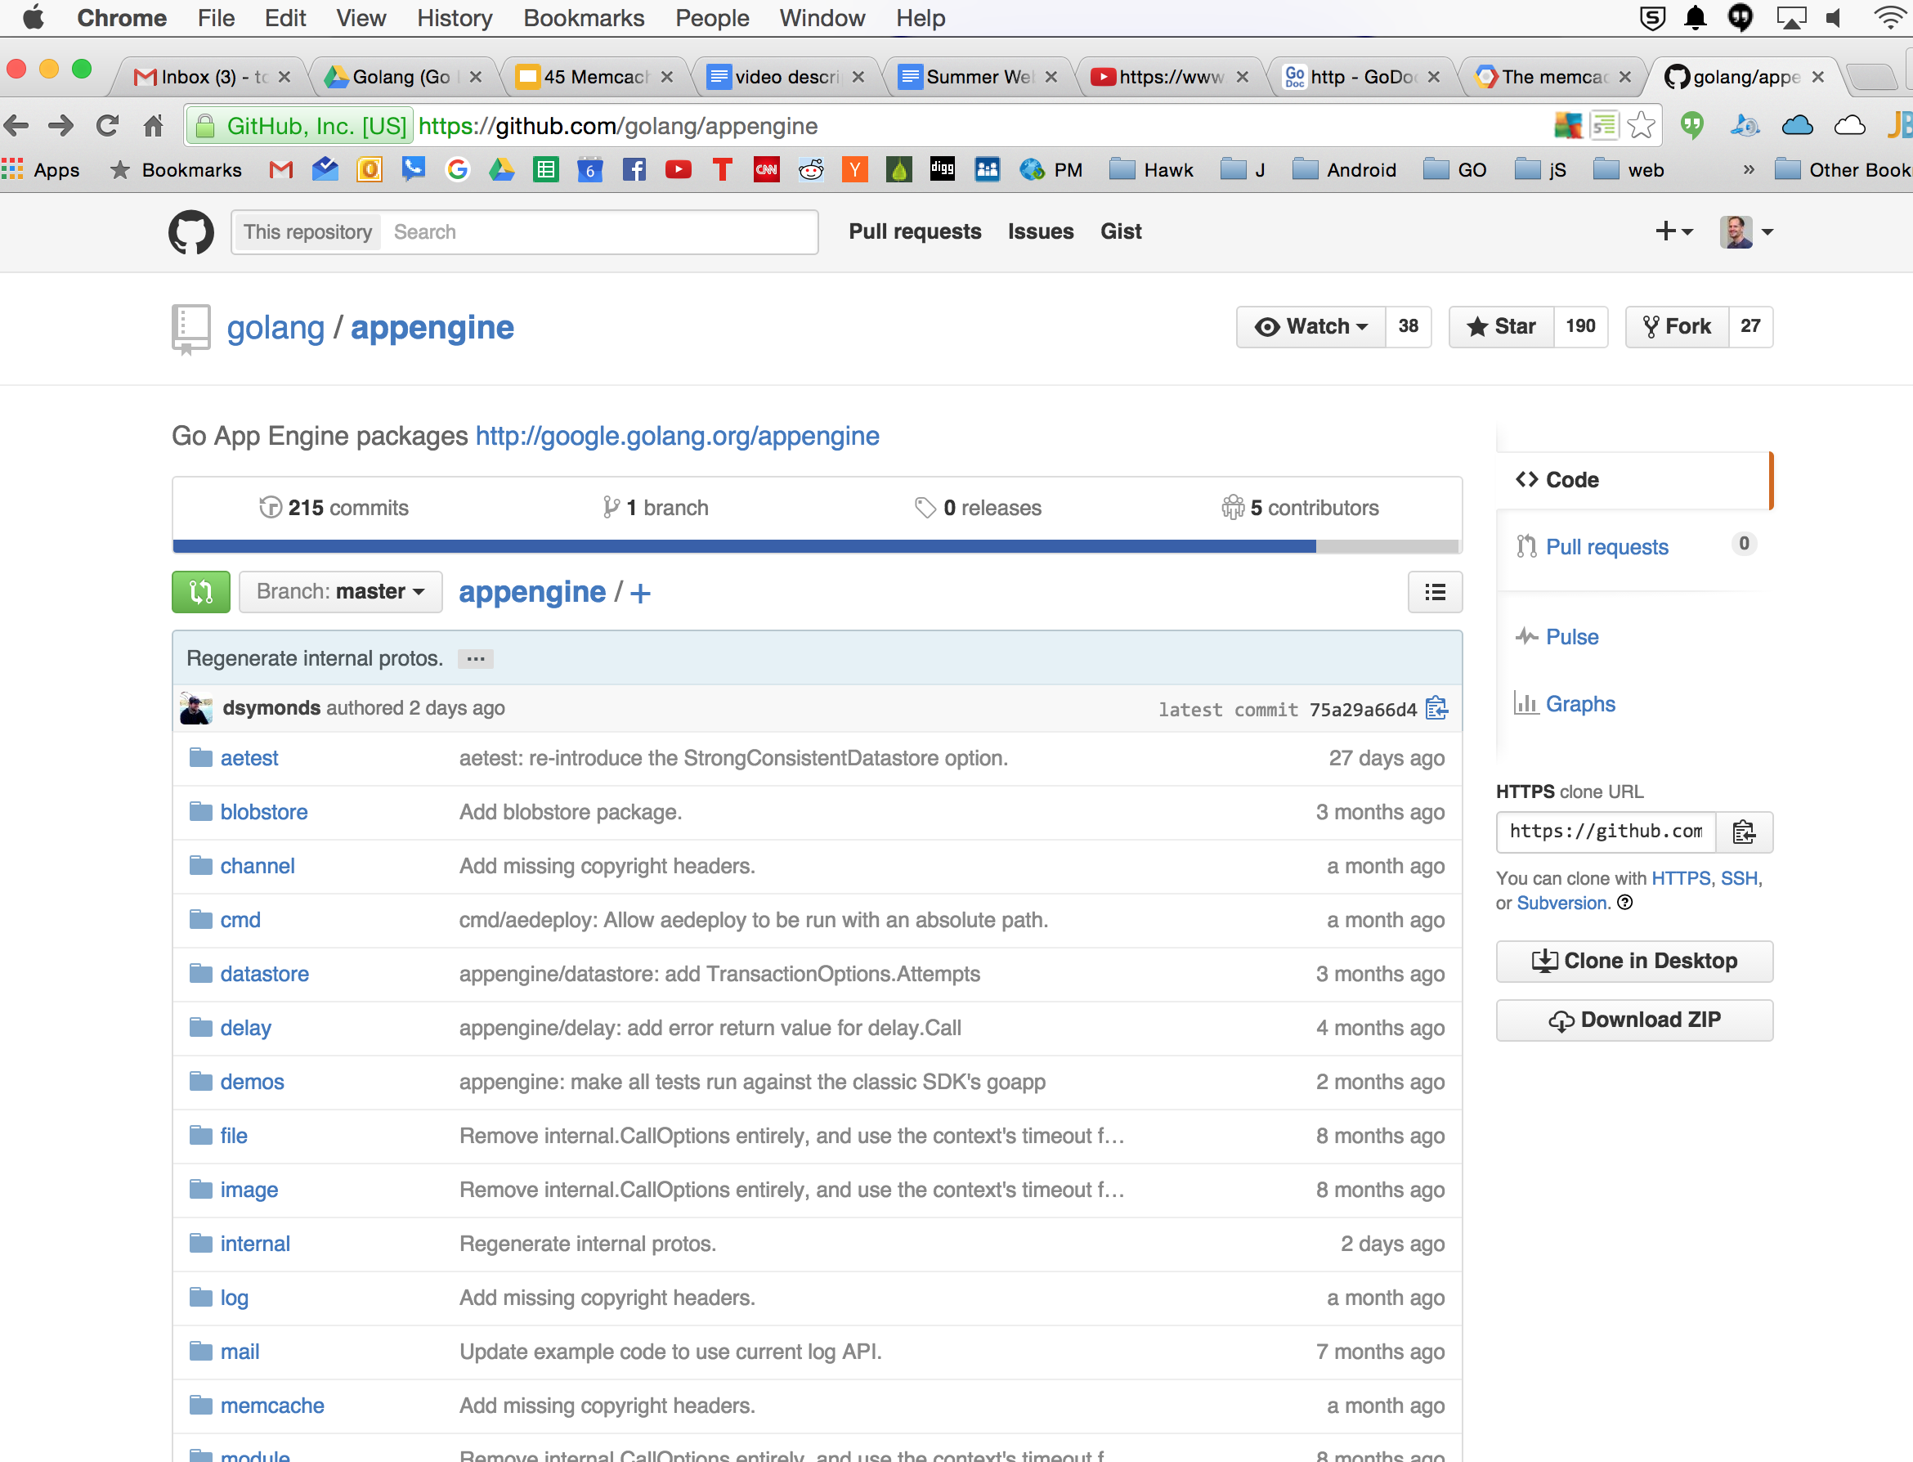
FYI

Slide 19
set, get, memcache.Item

Slide 20
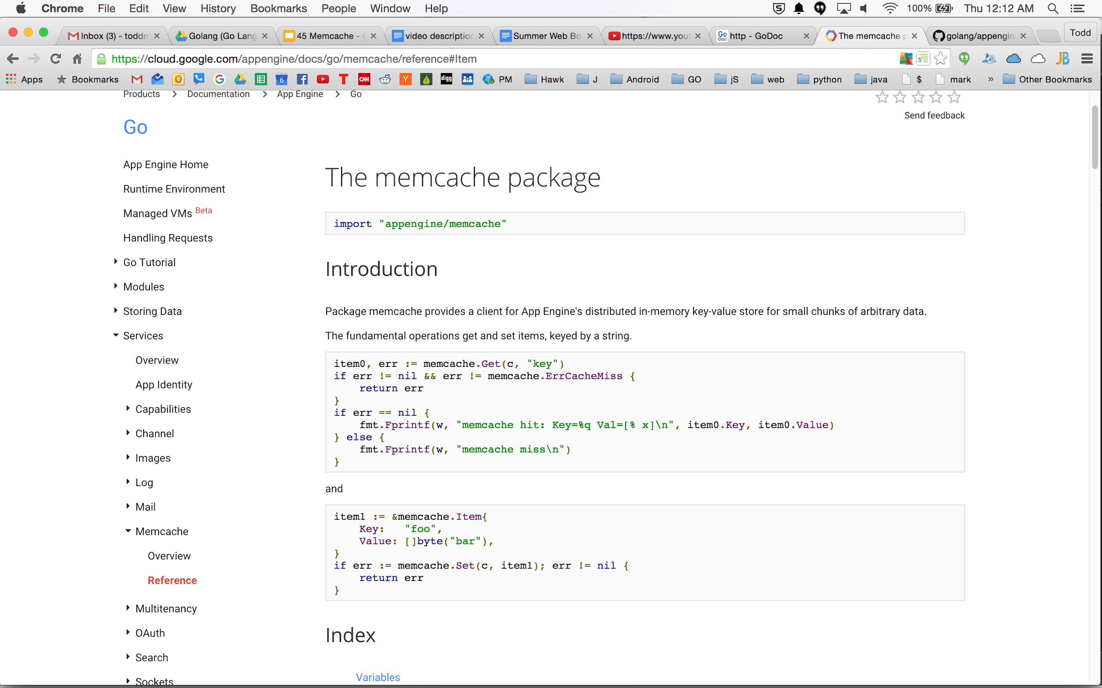

Slide 21
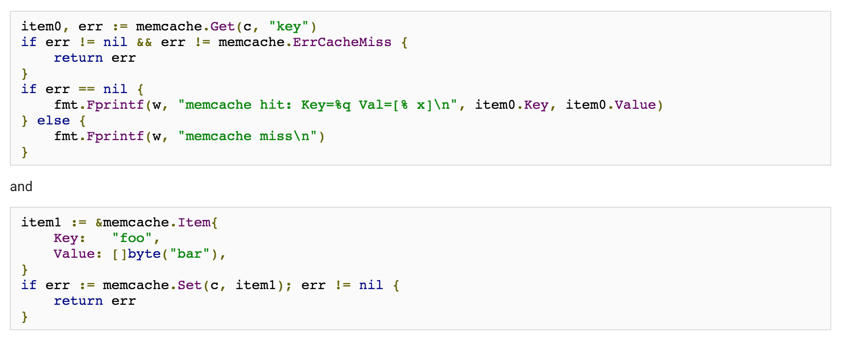

Slide 22
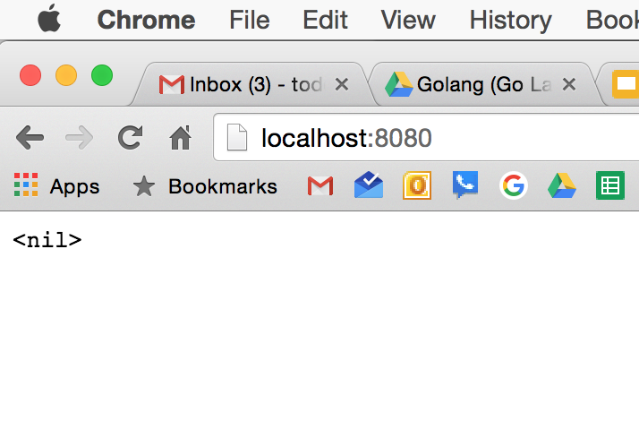
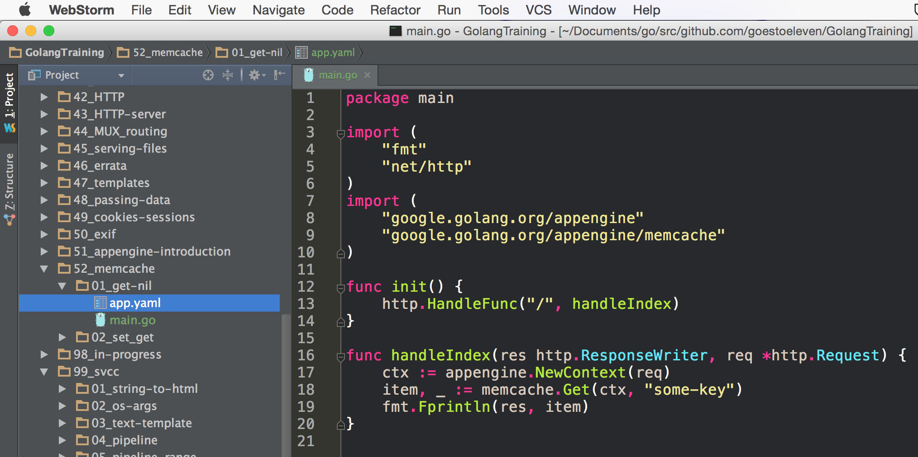

Slide 23
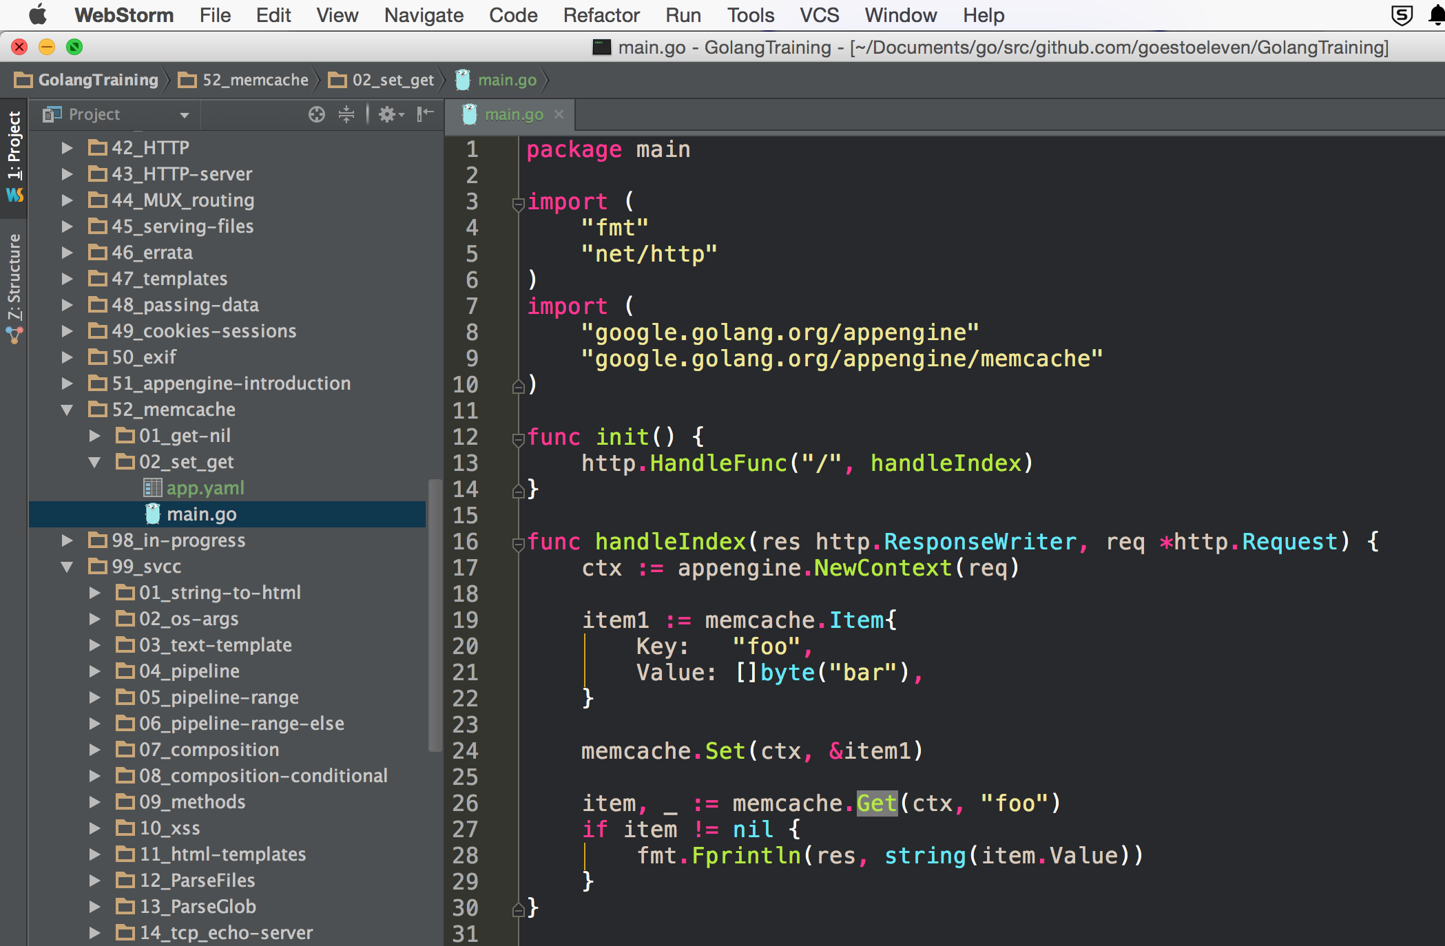
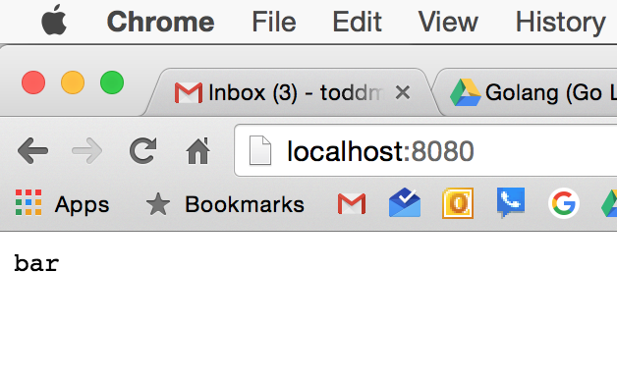

Slide 24
add

Slide 25
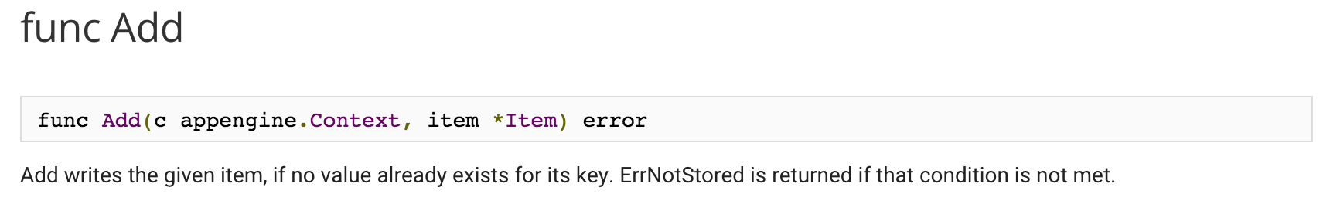

Slide 26
expiration

Slide 27
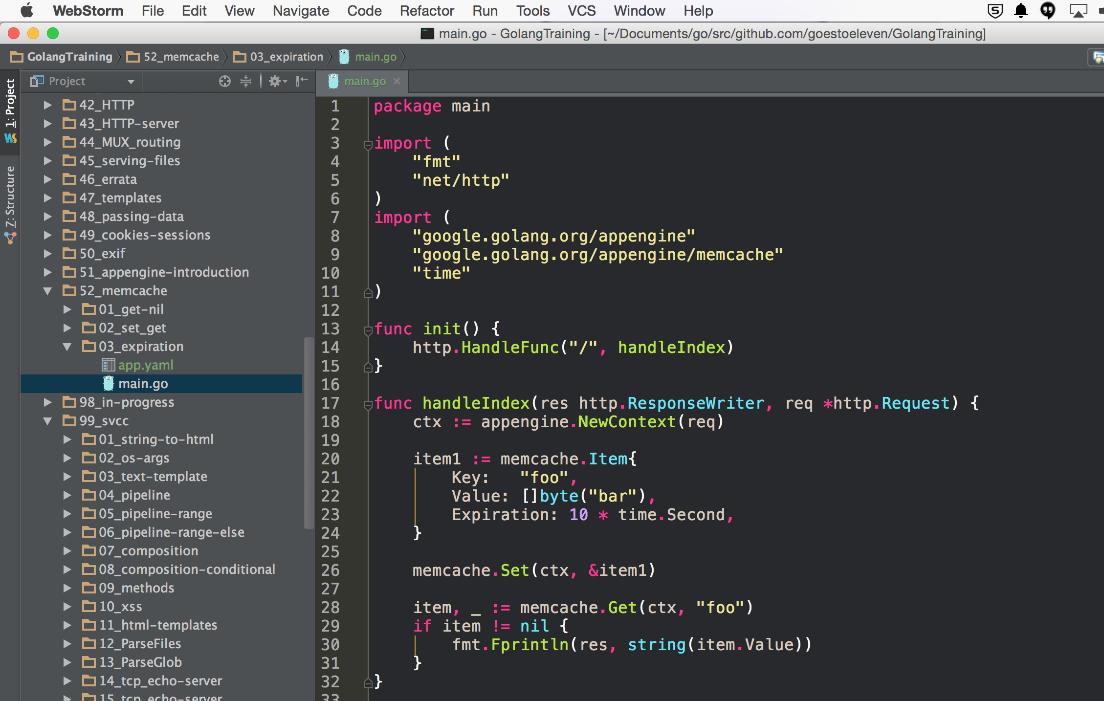
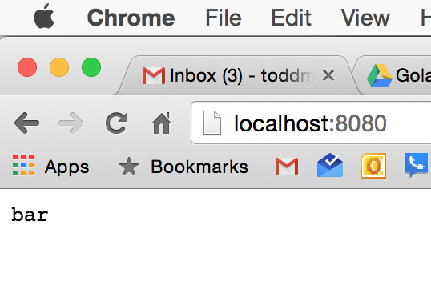
STEP 1

Slide 28
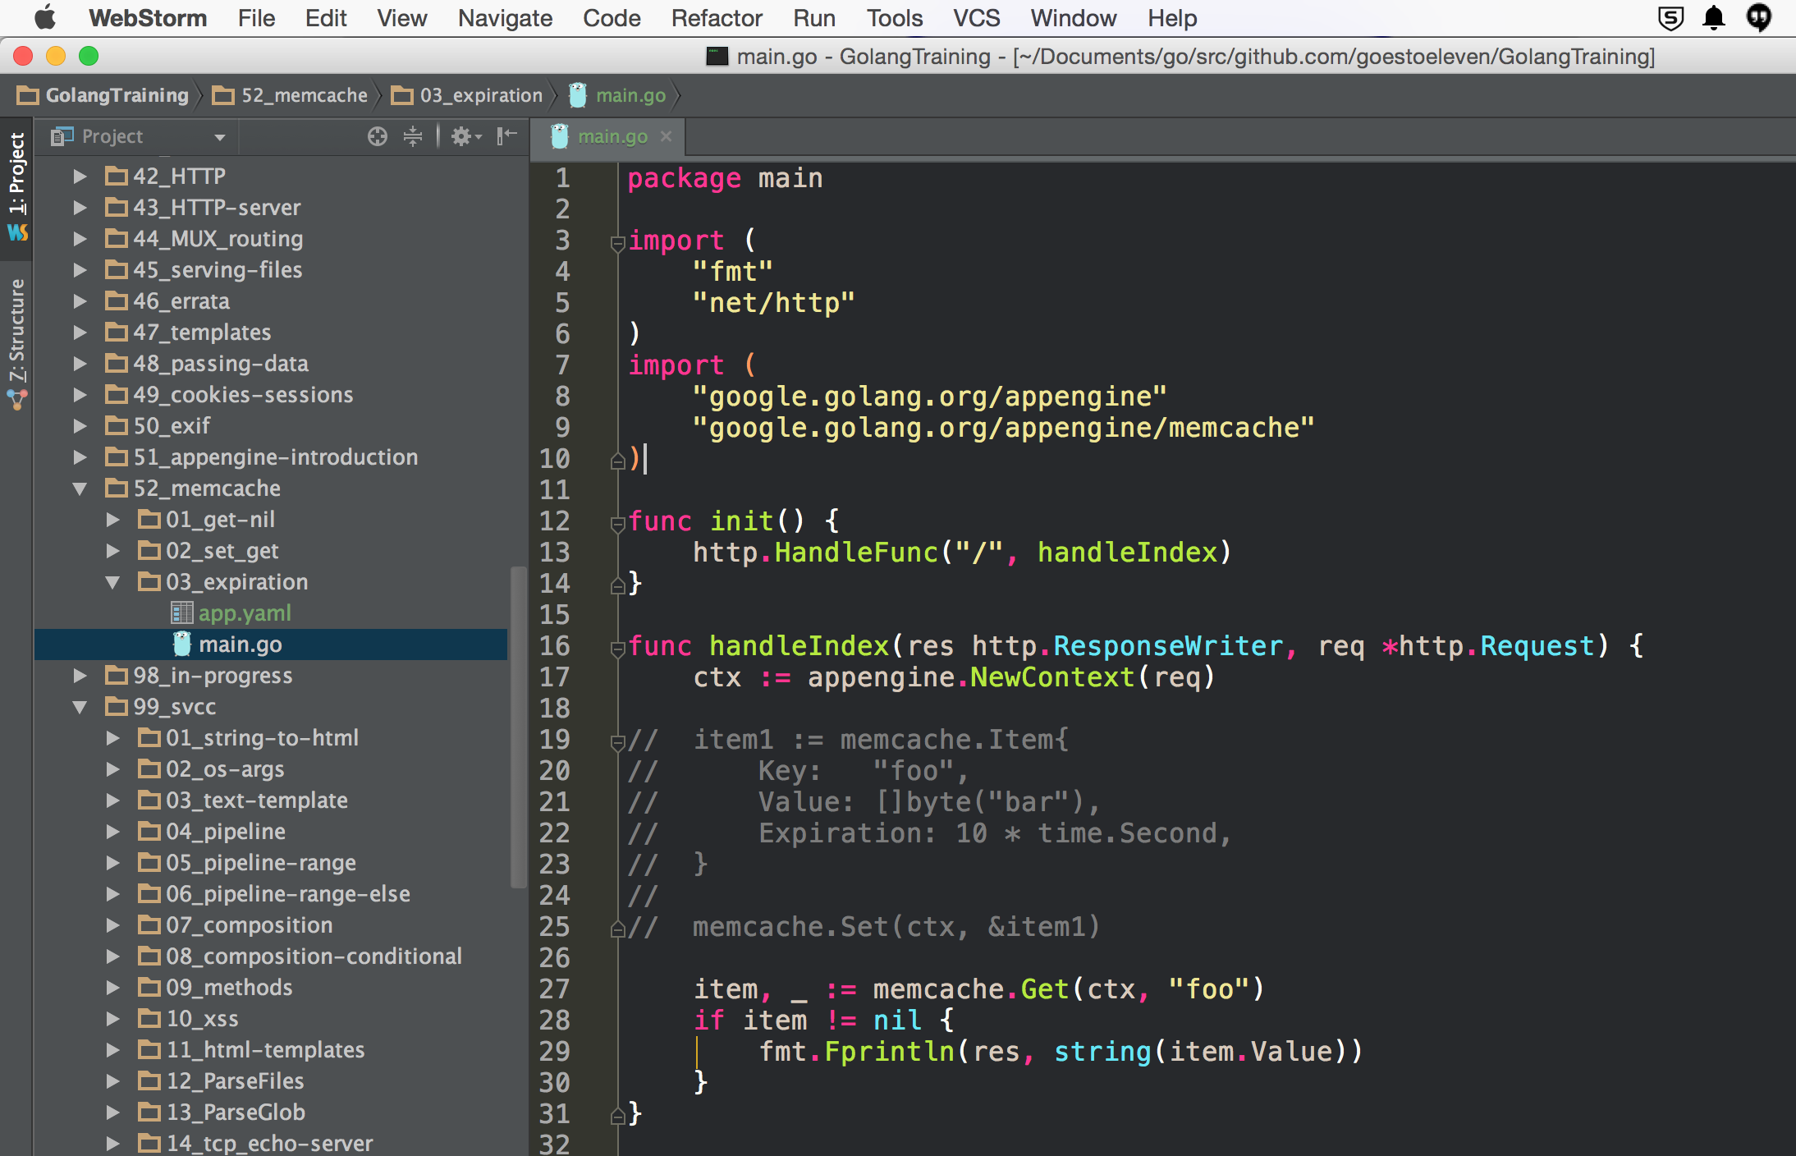
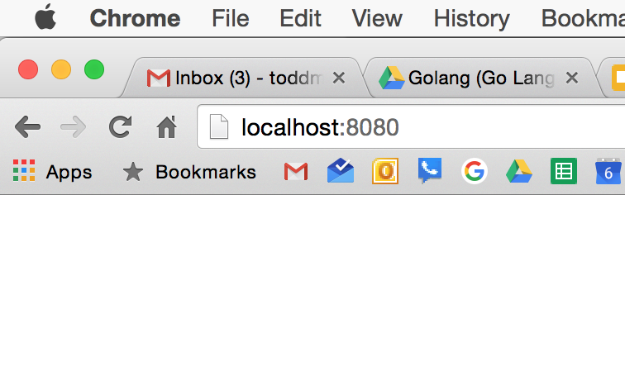
STEP 2

Slide 29
increment

Slide 30
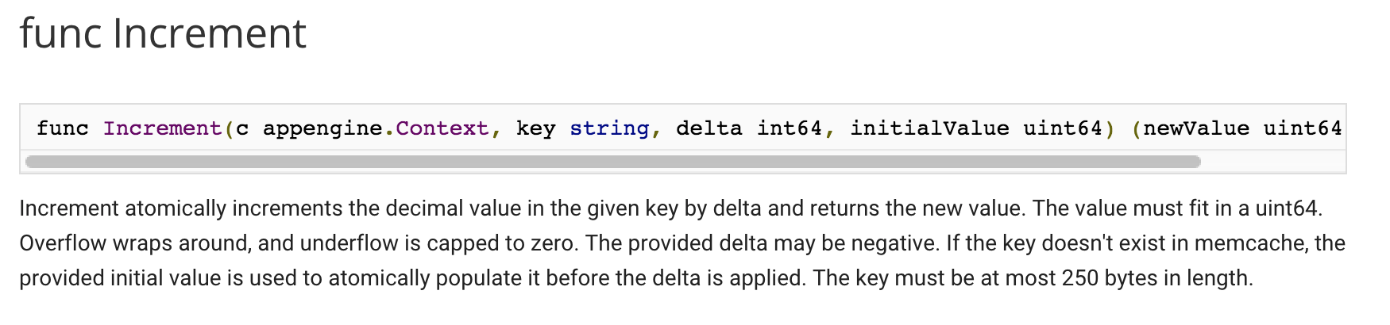

Slide 31
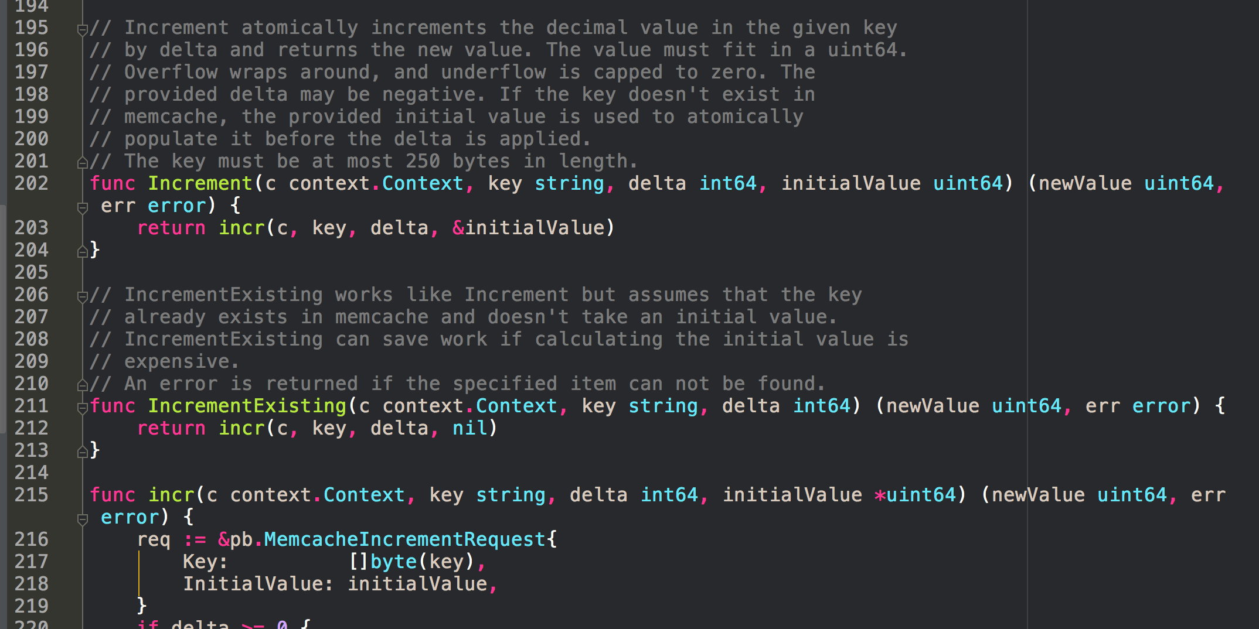

Slide 32
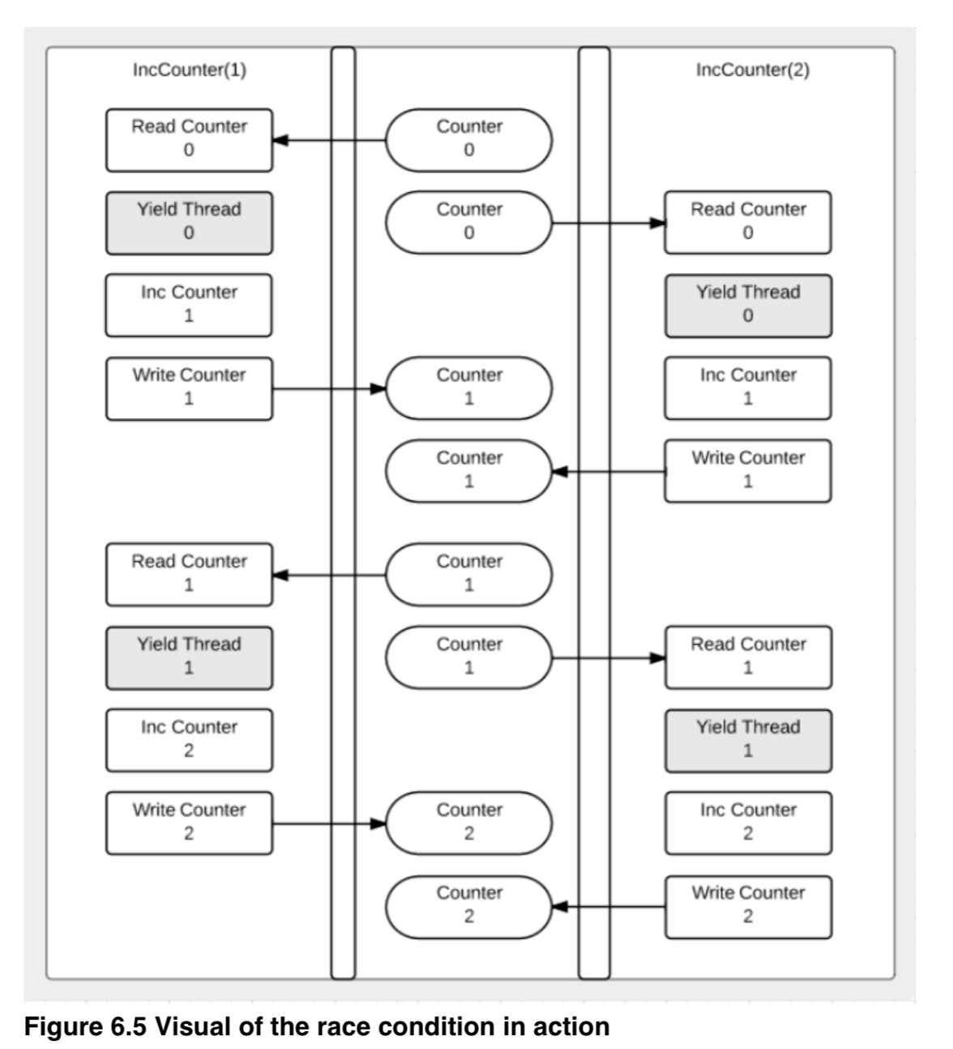
source: William Kennedy, Go In Action

Slide 33
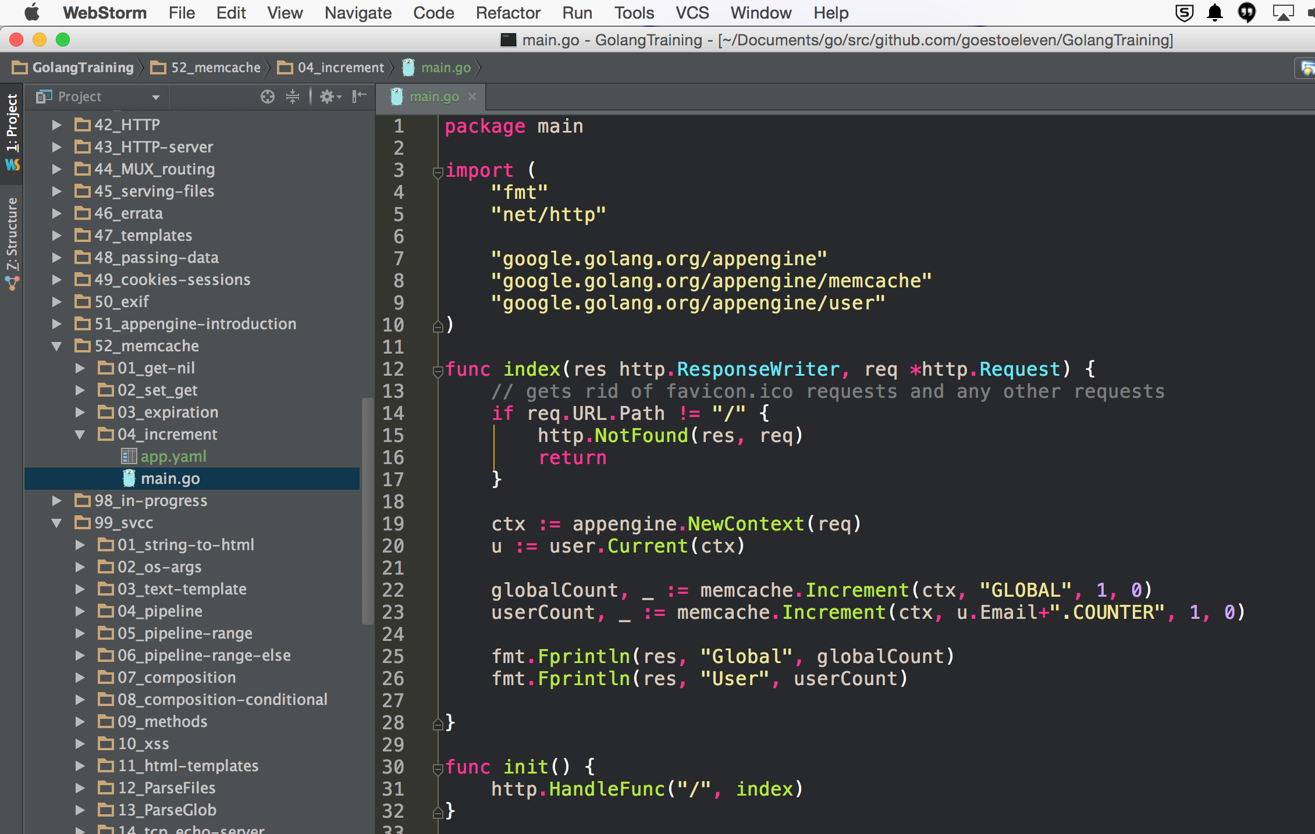

Slide 34
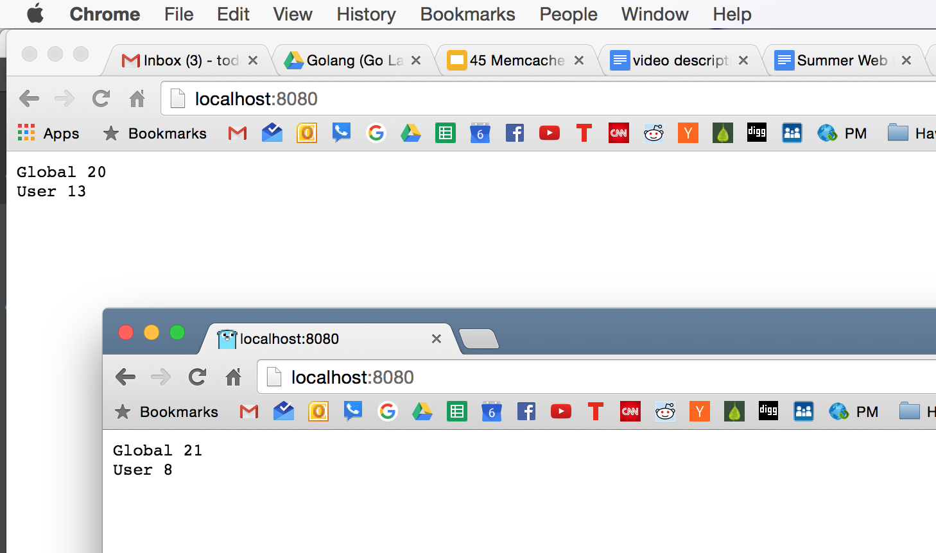

Slide 35
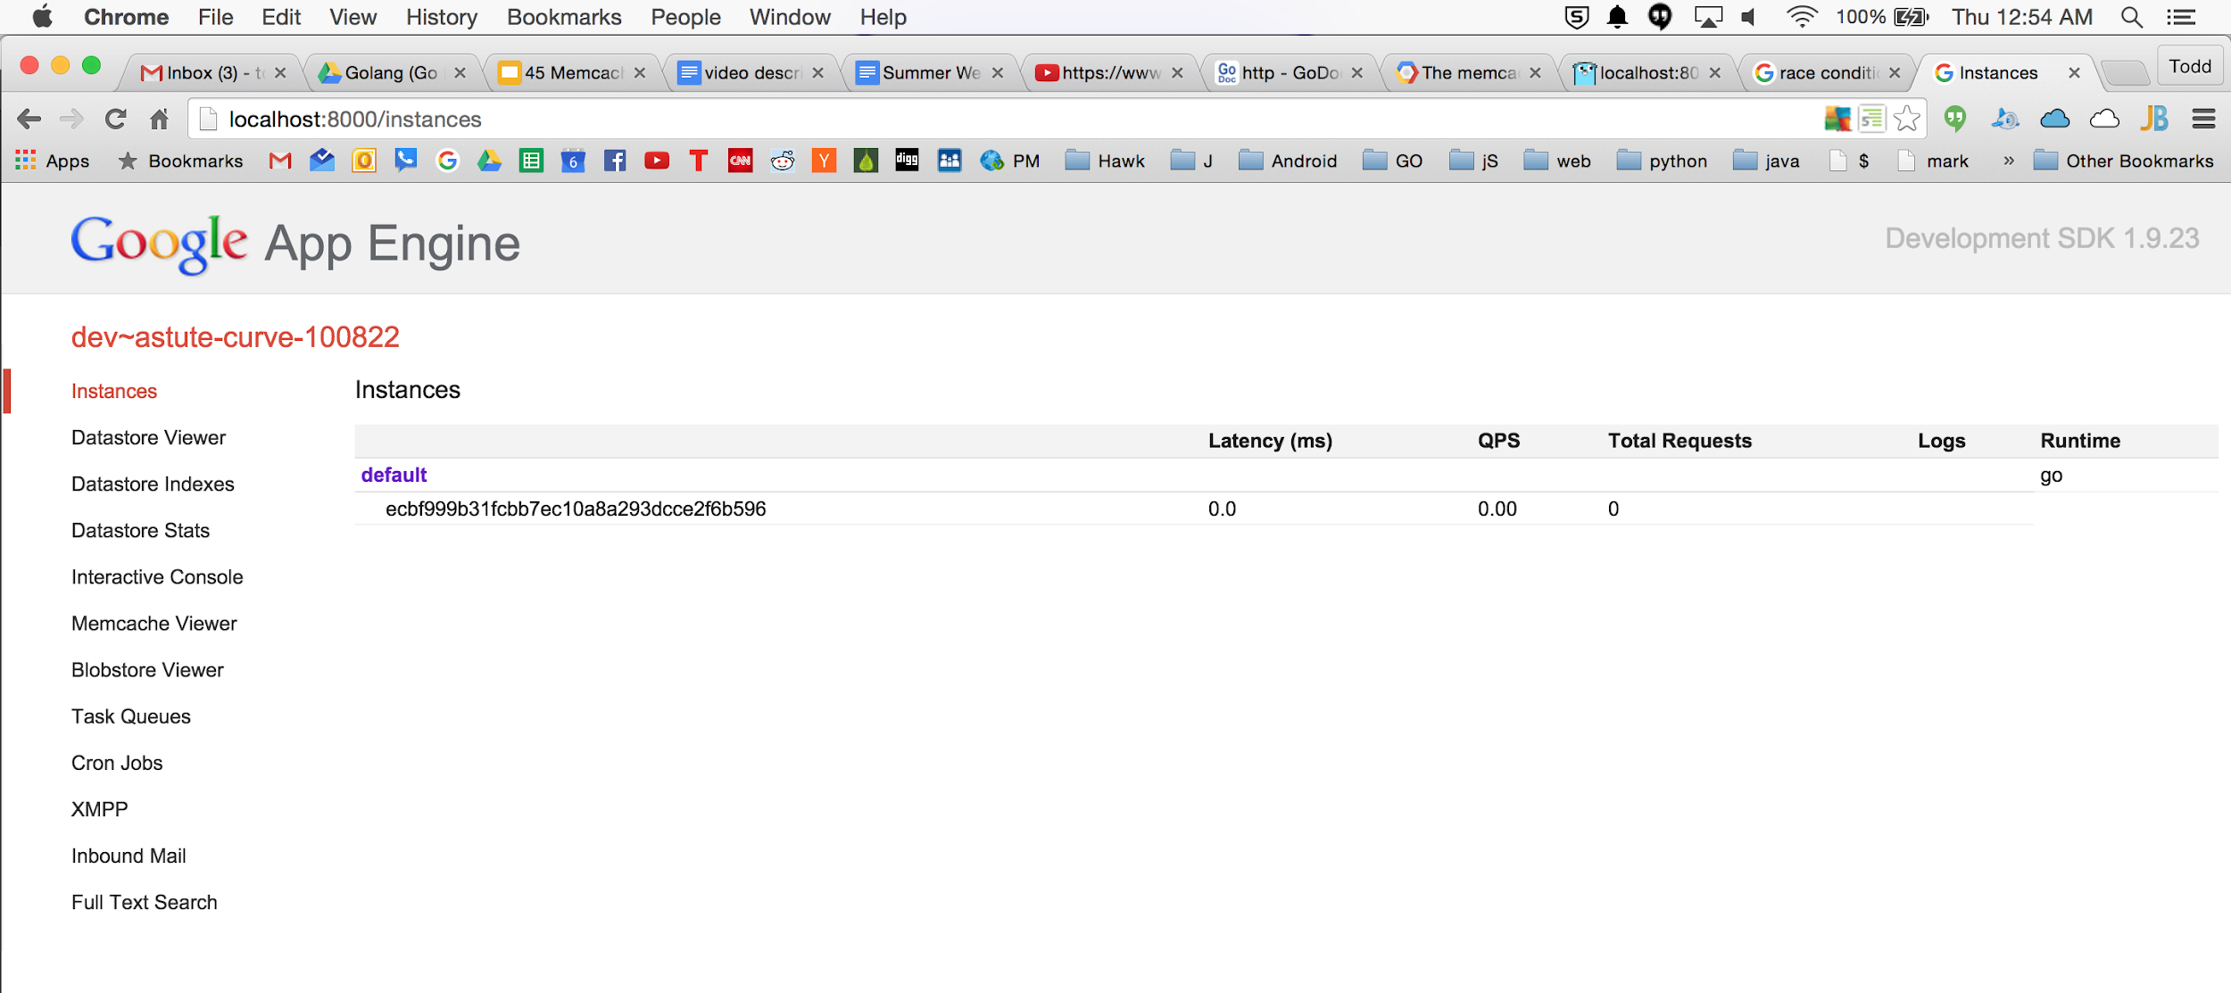

Slide 36
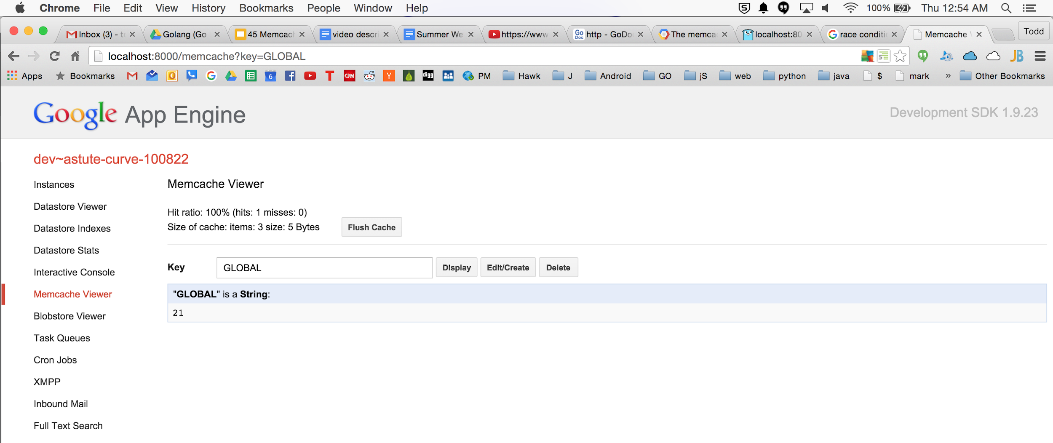

Slide 37
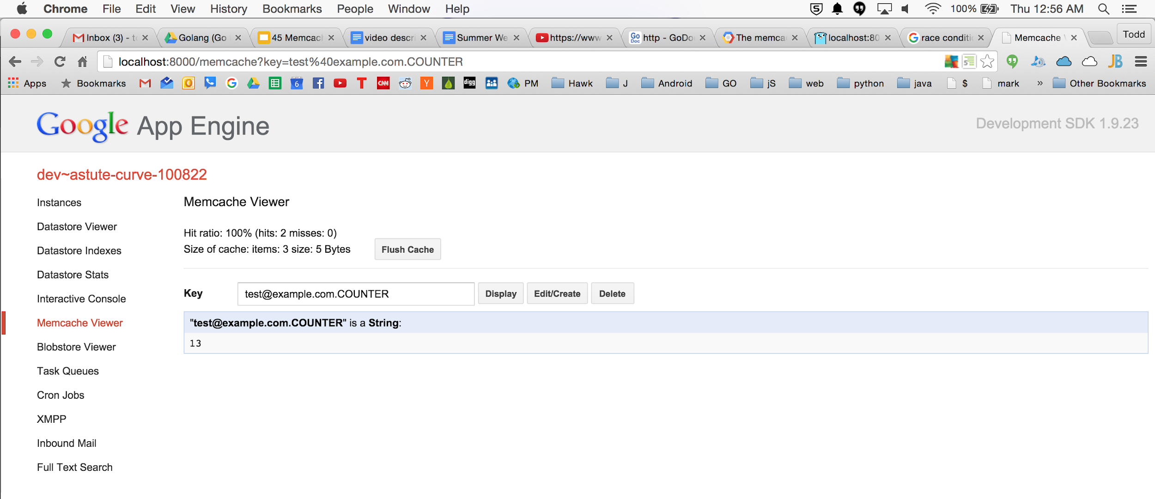

Slide 38
sessions with memcache

Slide 39
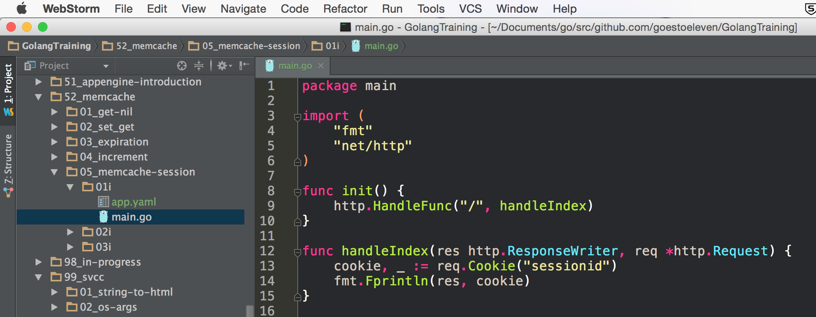
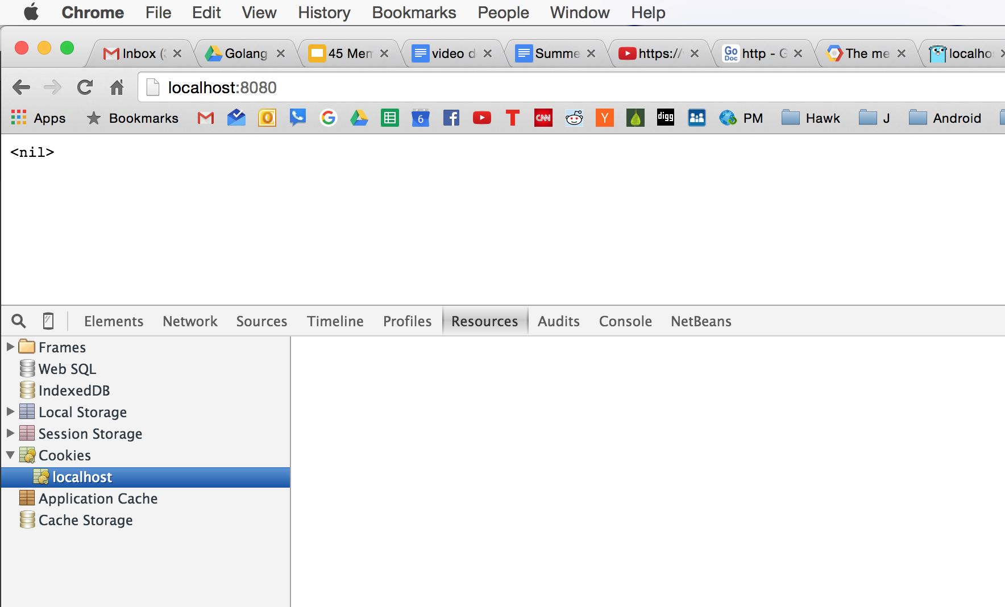

Slide 40
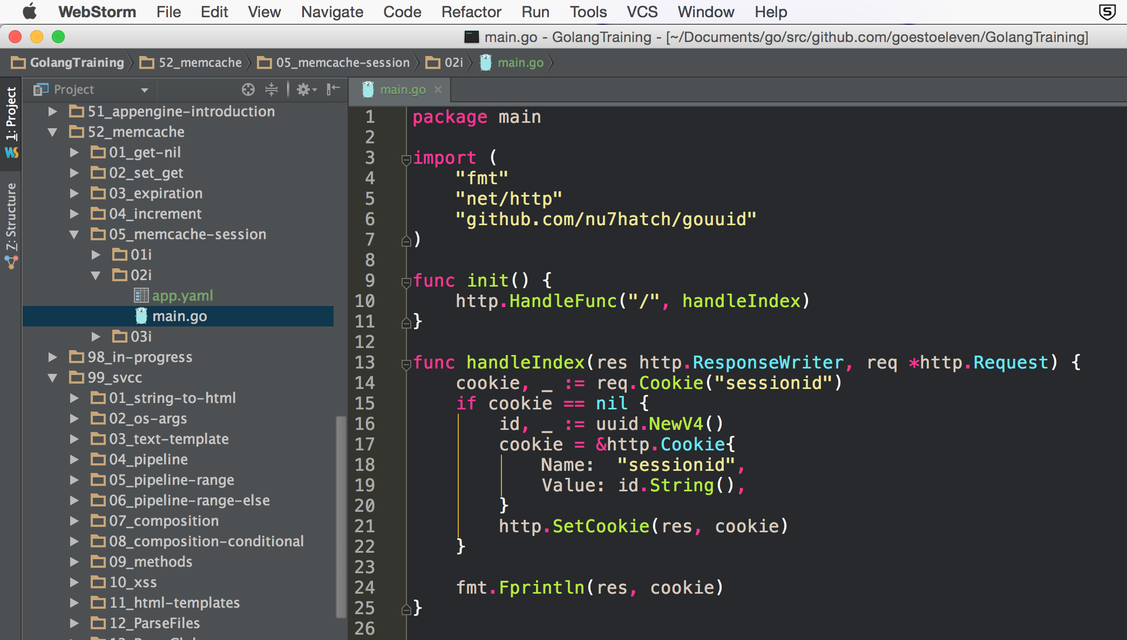
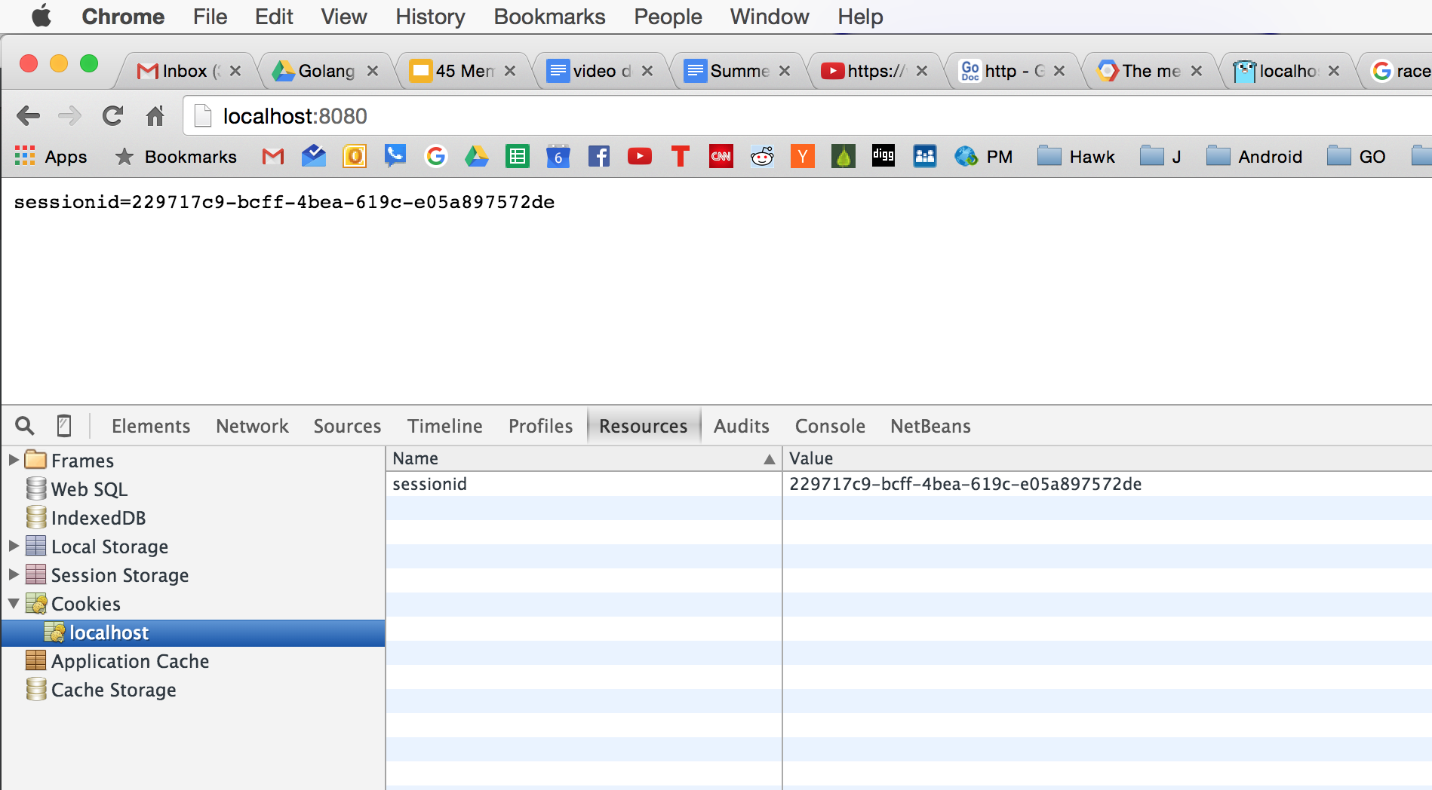

Slide 41
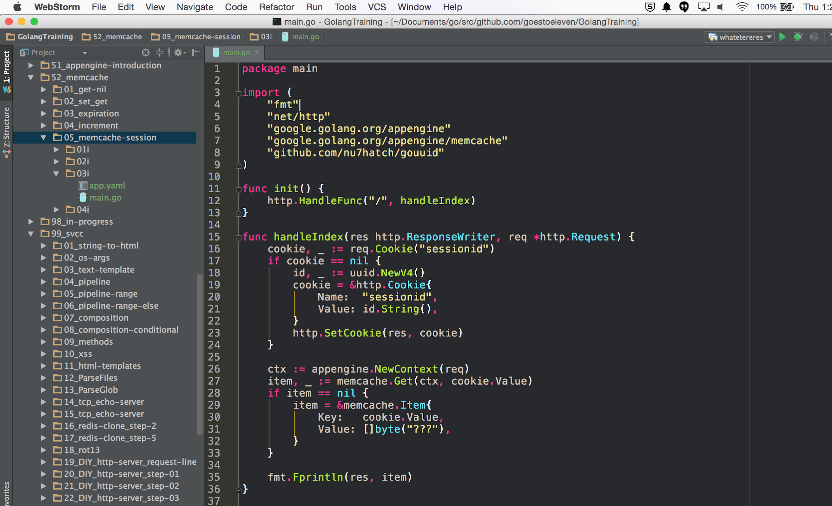
CODE

Slide 42
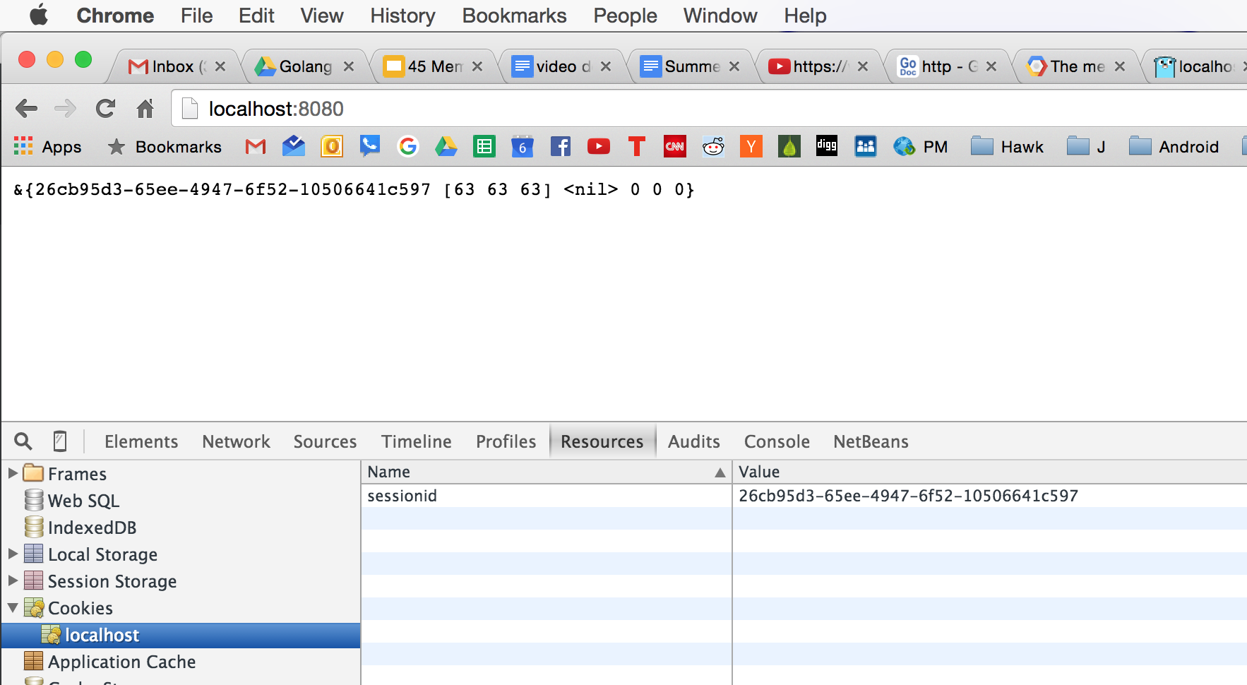
RESULT

Slide 43
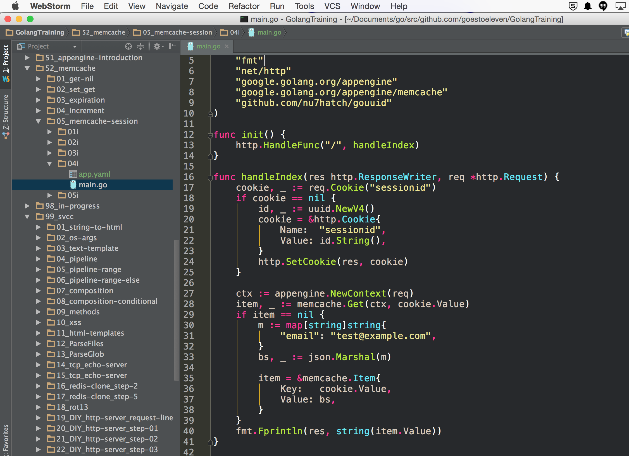
CODE

Slide 44
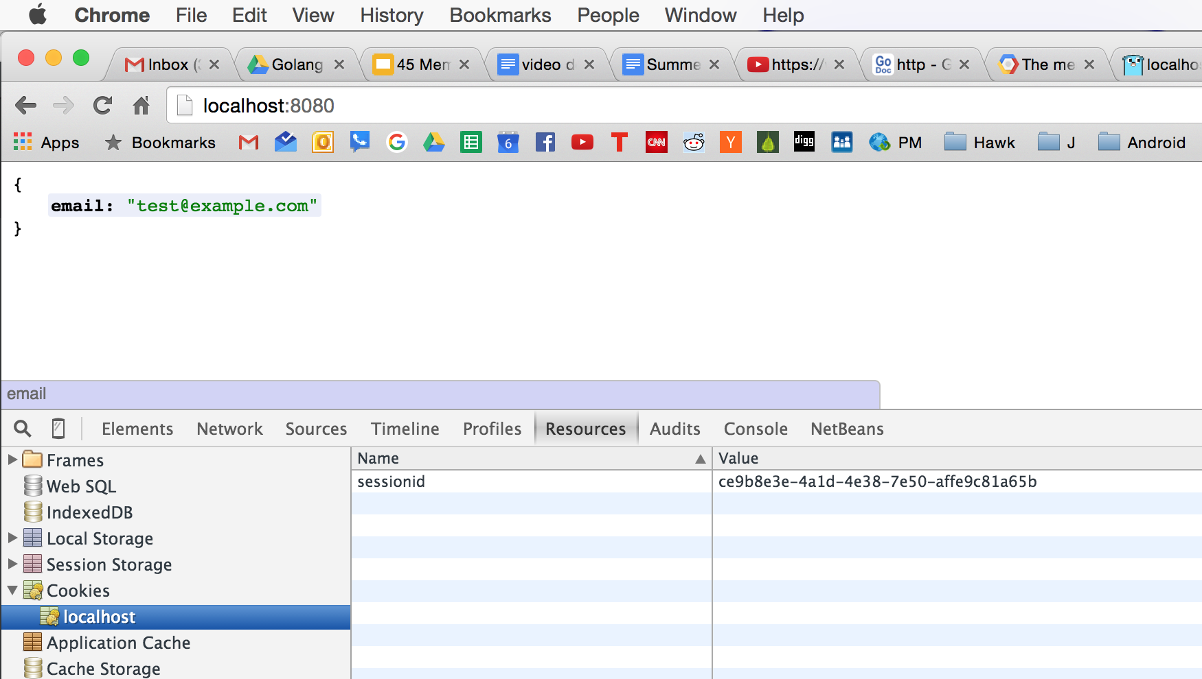
RESULT

Slide 45
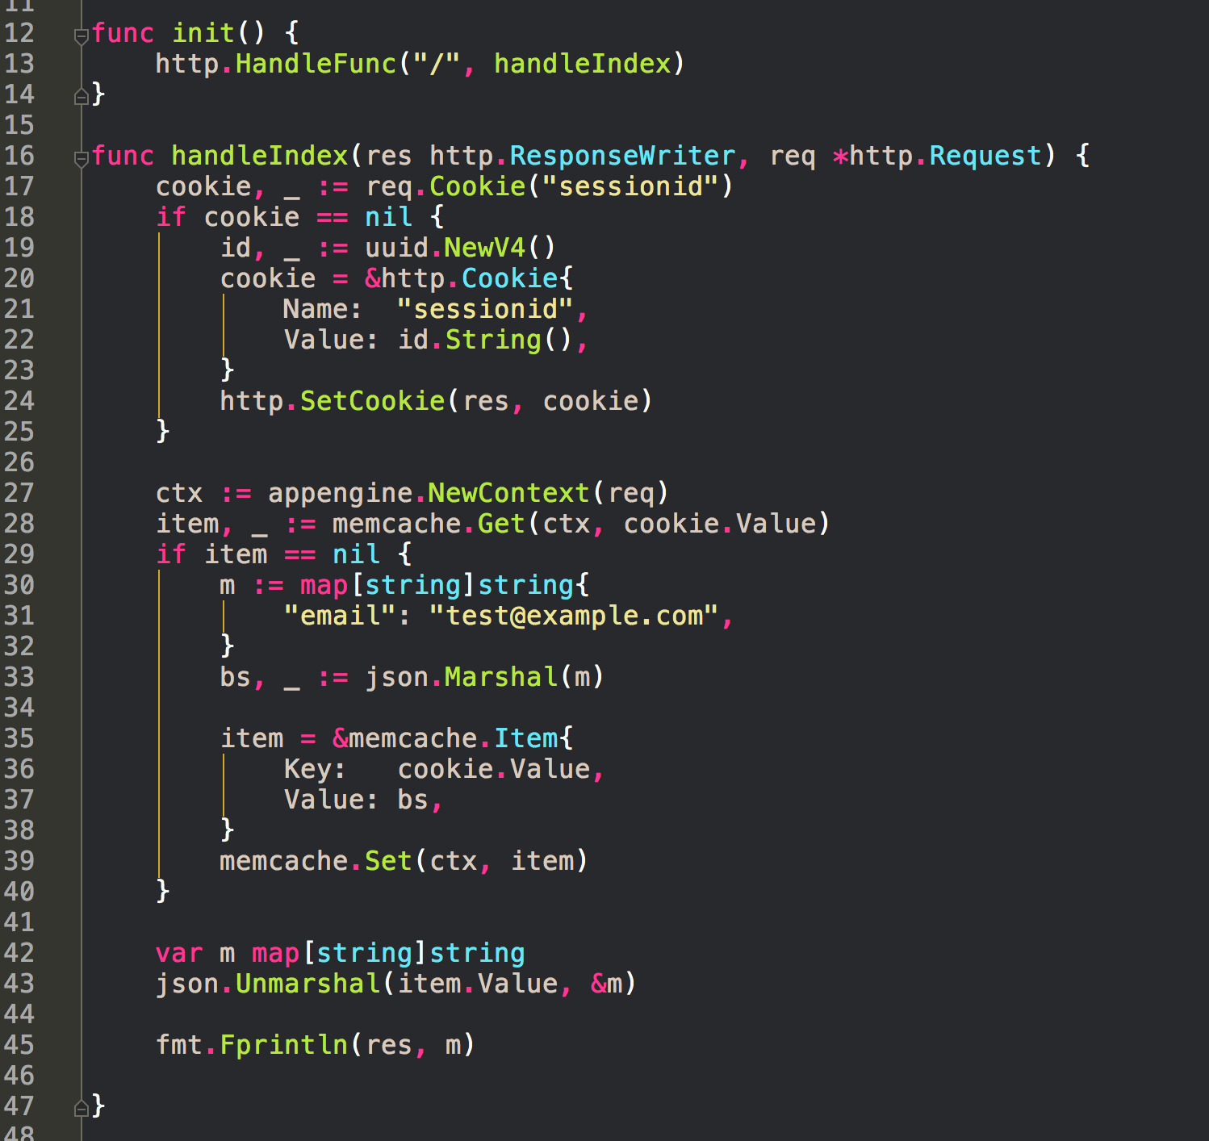
CODE

Slide 46
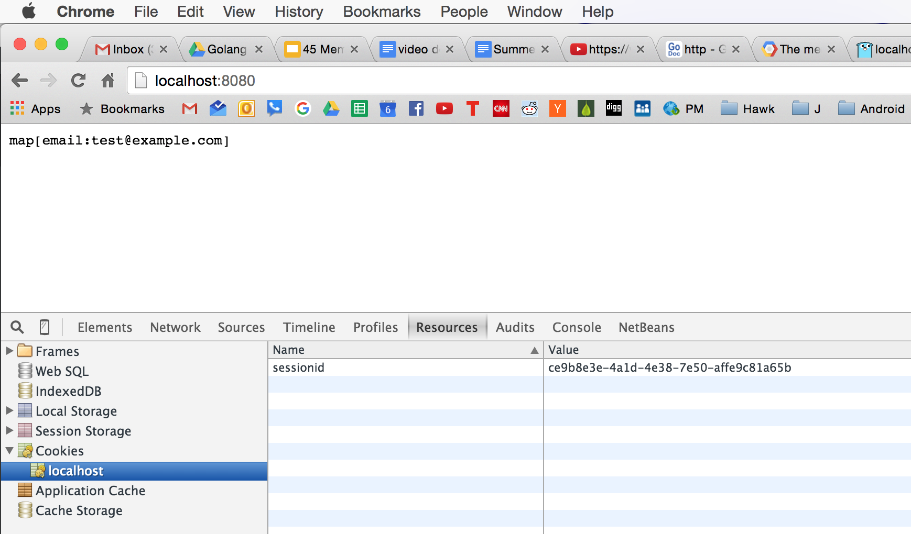
RESULT

Slide 47
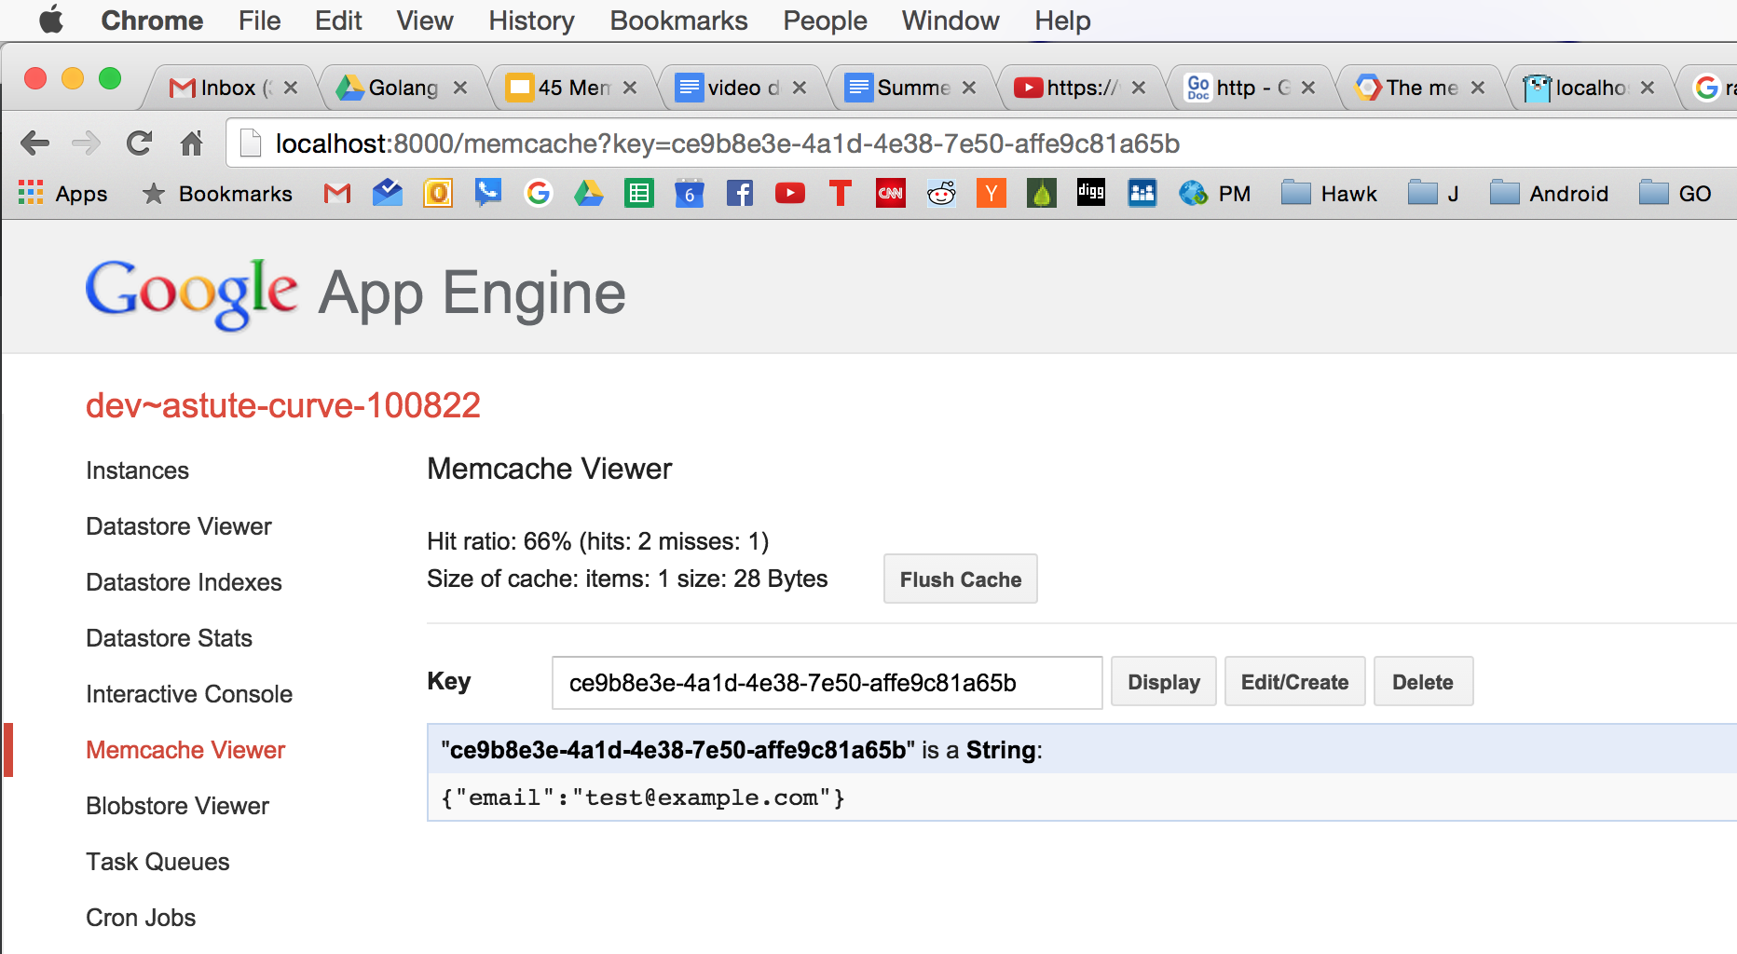
RESULT

Slide 48
photoblog with memcache

Slide 49
Don’t worry too much about HMAC
when only storing a UUID session ID in a cookie
https://www.youtube.com/watch?v=wVax6VvU9F0&t=15m40s
“... a lot of sites do it this way …”

